Slide 1
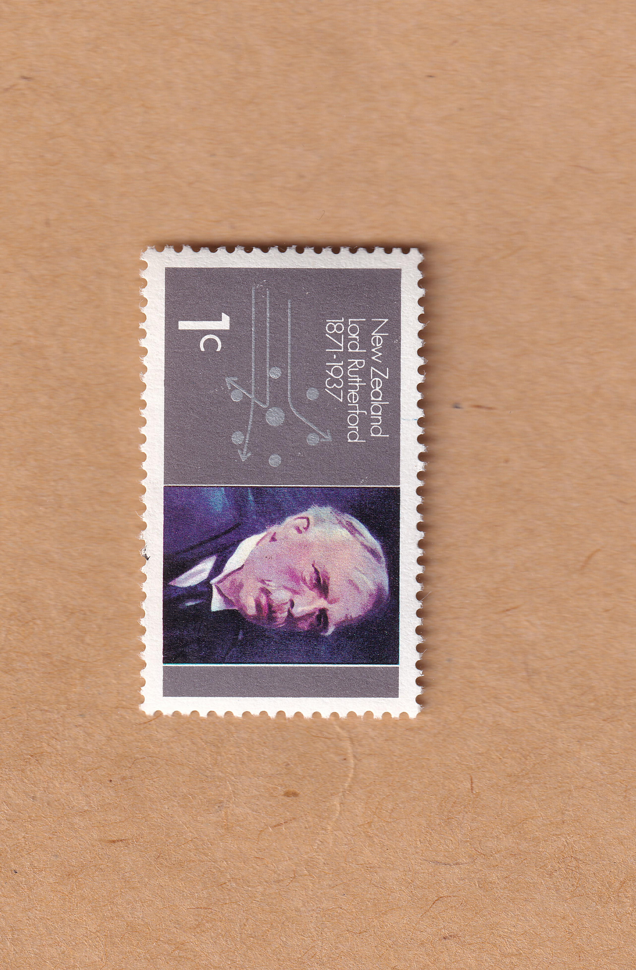
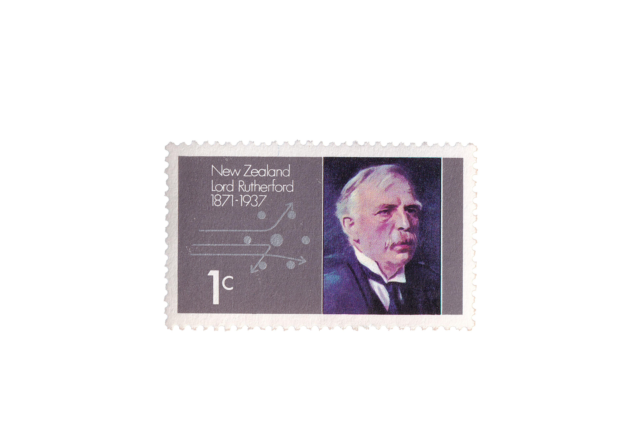
Crafting a talk – a personal take
Niels Kjærgaard
University of Otago
Notes:
First impressions are EXTREMELY important. This is true in everyday life. It holds true on the special occasions in life where it is do or die. And it holds true when giving a scientific presentation. You do NOT want to miss out on the opportunity of creating a positive momentum. And for a talk this begins with your first slide. Now, I am not going to give a scientific presentation today, but my opening slide is true to the following two points that I try to honor. 1) Keep the writing to a minimum an 2) I high quality illustration that can server

Slide 2
Crafting a talk – a personal take
Niels Kjærgaard
University of Otago
Notes:
First impressions are EXTREMELY important. This is true in everyday life. It holds true on the special occasions in life where it is do or die. And it holds true when giving a scientific presentation. You do NOT want to miss out on the opportunity of creating a positive momentum. And for a talk this begins with your first slide. Now, I am not going to give a scientific presentation today, but my opening slide is true to the following two points that I try to honor. 1) Keep the writing to a minimum an 2) I high quality illustration that can server

Slide 3
ELUCIDATING SCATTERING RESONANCES WITH AN ULTRACOLD ATOM COLLIDER
SCATTERING
?
Niels Kjærgaard
University of Otago
New Zealand

Slide 4
Show some humor?
Yes, but not too soon!
"All science is either physics or stamp collecting."
Nobel Prize in Chemistry (1908)

Slide 5
Crafting a talk – a personal take
Niels Kjærgaard
University of Otago
Notes:
First impressions are EXTREMELY important. This is true in everyday life. It holds true on the special occasions in life where it is do or die. And it holds true when giving a scientific presentation. You do NOT want to miss out on the opportunity of creating a positive momentum. And for a talk this begins with your first slide. Now, I am not going to give a scientific presentation today, but my opening slide is true to the following two points that I try to honor. 1) Keep the writing to a minimum an 2) I high quality illustration that can server

Slide 6
Crafting a talk – a personal take
Niels Kjærgaard
University of Otago
Notes:
First impressions are EXTREMELY important. This is true in everyday life. It holds true on the special occasions in life where it is do or die. And it holds true when giving a scientific presentation. You do NOT want to miss out on the opportunity of creating a positive momentum. And for a talk this begins with your first slide. Now, I am not going to give a scientific presentation today, but my opening slide is true to the following two points that I try to honor. 1) Keep the writing to a minimum an 2) I high quality illustration that can server

Slide 7
Crafting a talk – a personal take
Niels Kjærgaard
University of Otago
Notes:
First impressions are EXTREMELY important. This is true in everyday life. It holds true on the special occasions in life where it is do or die. And it holds true when giving a scientific presentation. You do NOT want to miss out on the opportunity of creating a positive momentum. And for a talk this begins with your first slide. Now, I am not going to give a scientific presentation today, but my opening slide is true to the following two points that I try to honor. 1) Keep the writing to a minimum an 2) I high quality illustration that can server

Slide 8
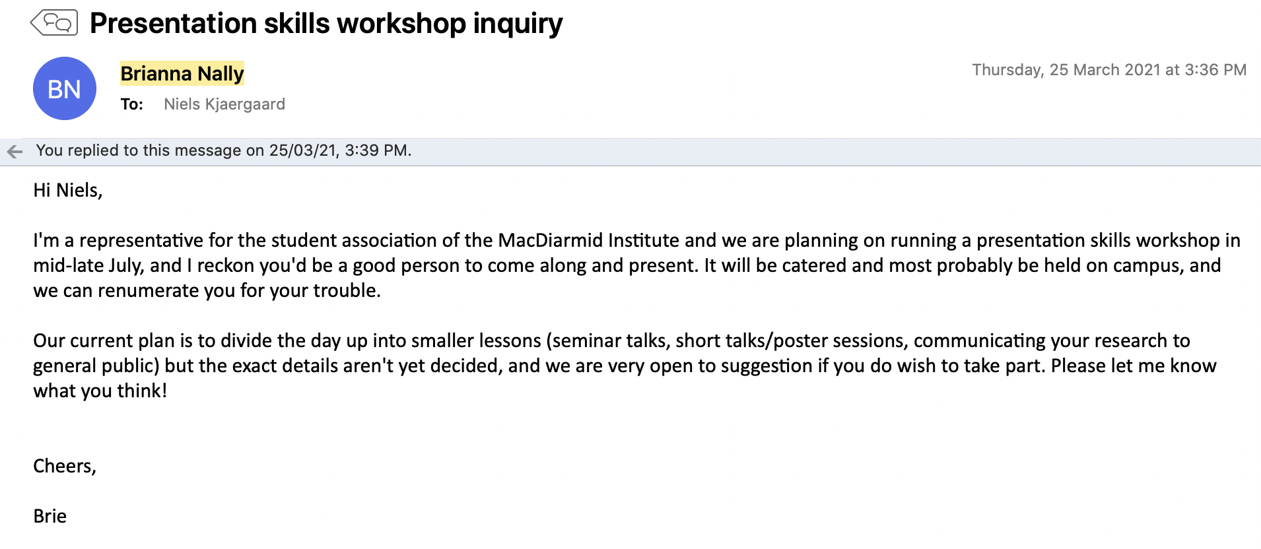

Crafting a good talk begins as soon as you receive the invitation
No
Yes
You need to have a message / result/ salient idea !

Slide 9
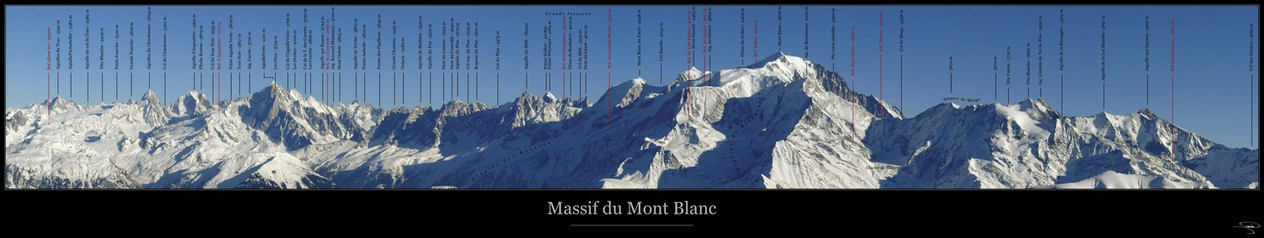
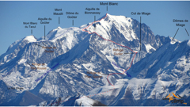
Life is short – People’s time is precious: You need give them something valuable to carry from you talk
one thing
You are allowed one unintelligible slide to make a point

Slide 10

Life is short – People’s time is precious: You need give them something valuable to carry from you talk
one thing

Slide 11
Life is short – People’s time is precious: You need give them something valuable to carry from you talk
one thing

Slide 12
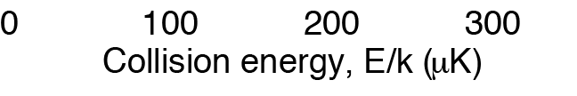
Identify
make perfect (font size etc)

Slide 13
Identify
make perfect (font size etc)
How to get there?
What is needed
to explain this?
Start

Slide 14
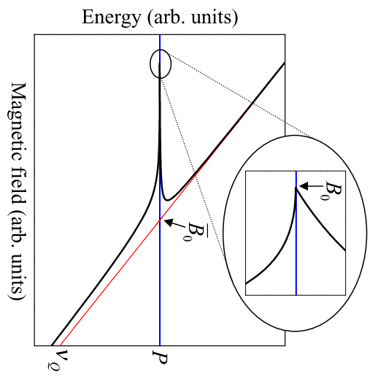
Identify
make perfect (font size etc)
How to get there?
What is needed
to explain this?
Promise
(This is a contract with
your audience)
Start

Slide 15
Identify
make perfect (font size etc)
How to get there?
Complete start-to-result stage before attacking this
What is needed
to explain this?
Promise
(This is a contract with
your audience)
Start
Finish

Slide 16
Unless you are an artist, putting items on a grid is your best bet
Salient idea/result
Promise
Complete start-to-result
stage before attacking this
How to get there?
Start
Finish
What is needed
to explain this?

Slide 17
You should aim for making “assertion-evidence” slides
topic-phrase headline
bullet point list
assertion-evidence

Slide 19
You should aim for making “assertion-evidence” slides

Slide 21
Very small top margin
Sans serif font. Font size not too big. Long sentence OK but two lines max
Very little noise:
No logo, footer or fancy backgrounds

Slide 22
Don’t apologise – Either own it or do a better job

Slide 23
AE
1. Build your talk on messages (not topics). 2. Support these messages with visual evidence (not bullet lists). 3. Explain this evidence by fashioning words on the spot.
https://www.assertion-evidence.com/
Note the tautology in 2 above

Slide 24
Bulleted lists can converted to suit the medium of a talk
1. Build your talk on messages (not topics). 2. Support these messages with visual evidence (not bullet lists). 3. Explain this evidence by fashioning words on the spot.

Slide 25
AE slides can also call for improvement
Before
After

Slide 26
AE slides can also call for improvement
Before
After

Slide 27
Making an empowerment promise at the beginning of your talk gives your audience a reason for engaging

Slide 28
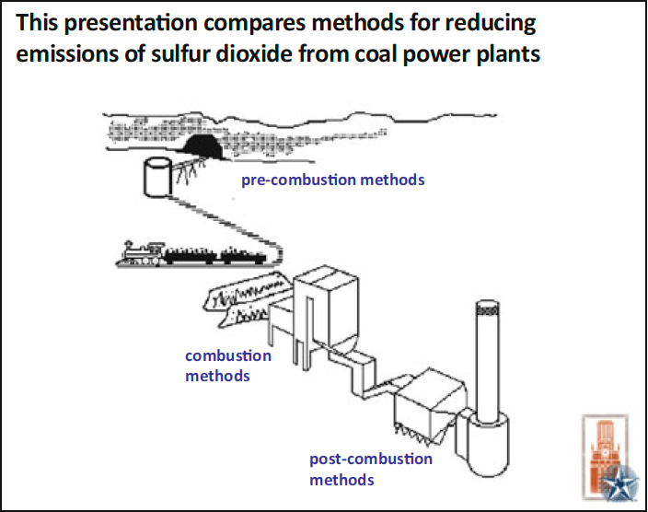
Making an empowerment promise at the beginning of your talk gives your audience a reason to engage
Promise: Death by PowerPoint
Mapping slide

Slide 29
Making an empowerment promise at the beginning of your talk gives your audience a reason to engage
Make use of “symbols” and
reoccurring elements

Slide 30
You can make it personal

Slide 31
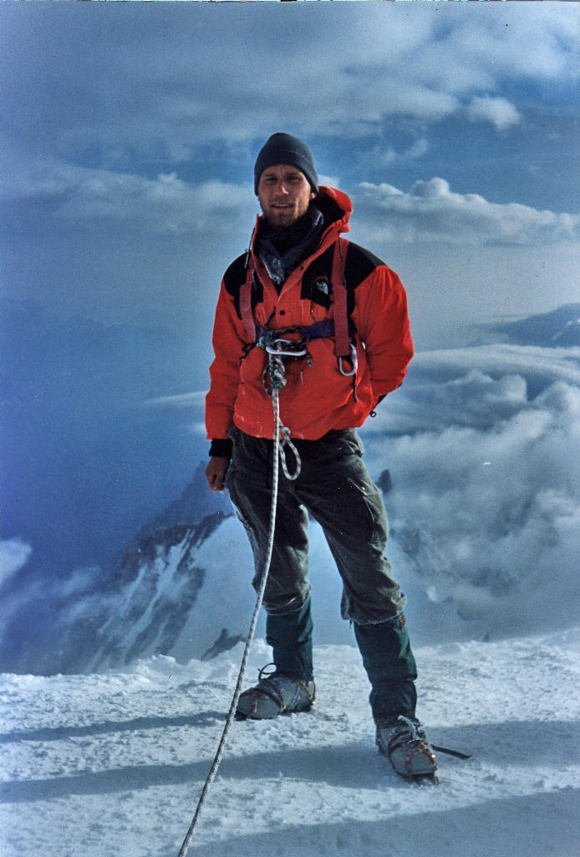

Slide 32
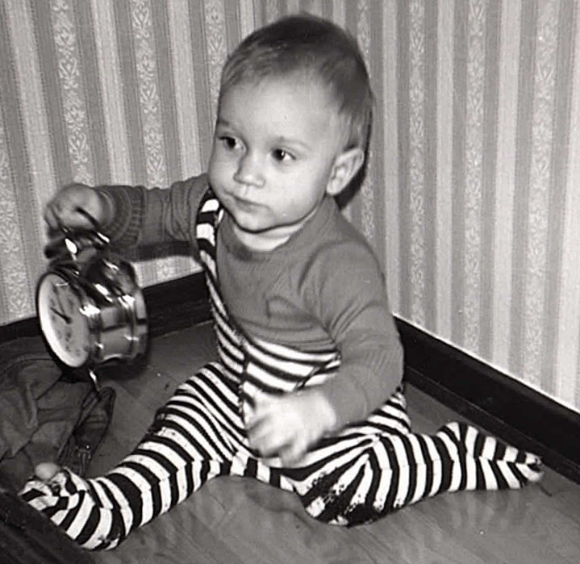
Bringing yourself into play connects you to your audience
No need for heroics—
showing your
human side works better
in fact

Slide 33
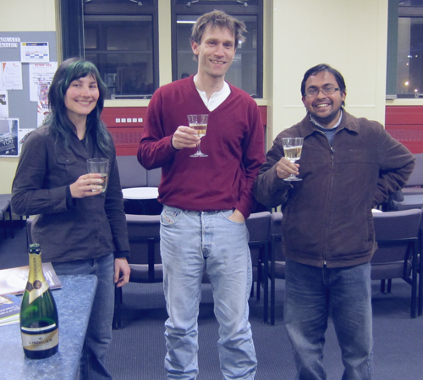
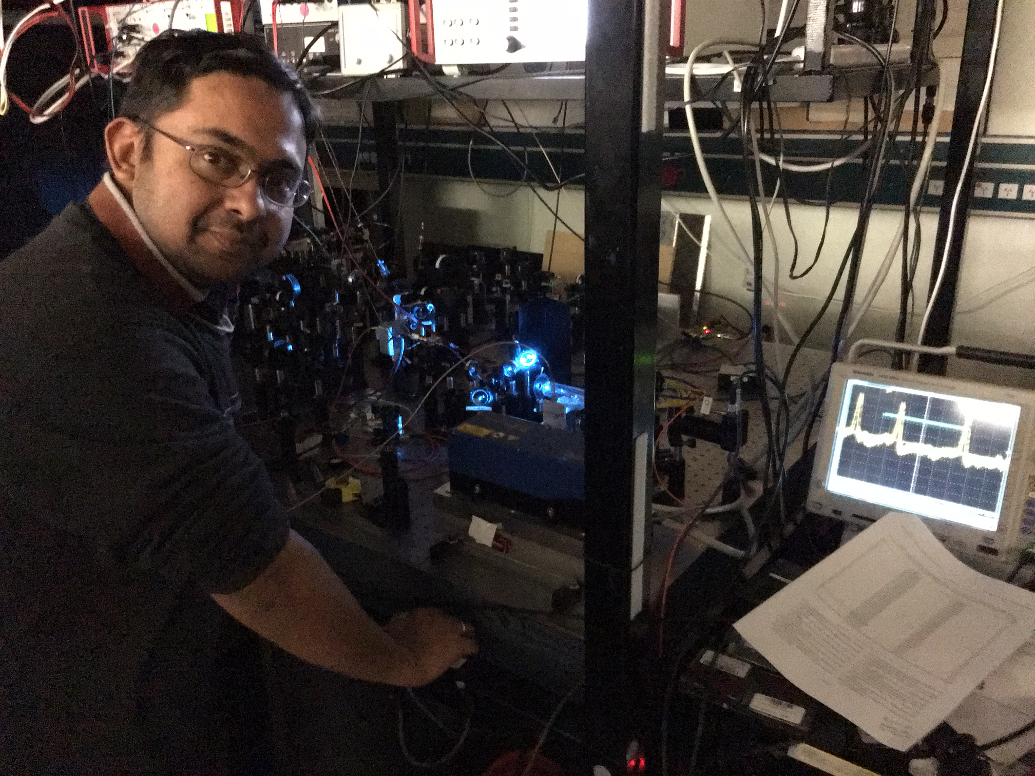
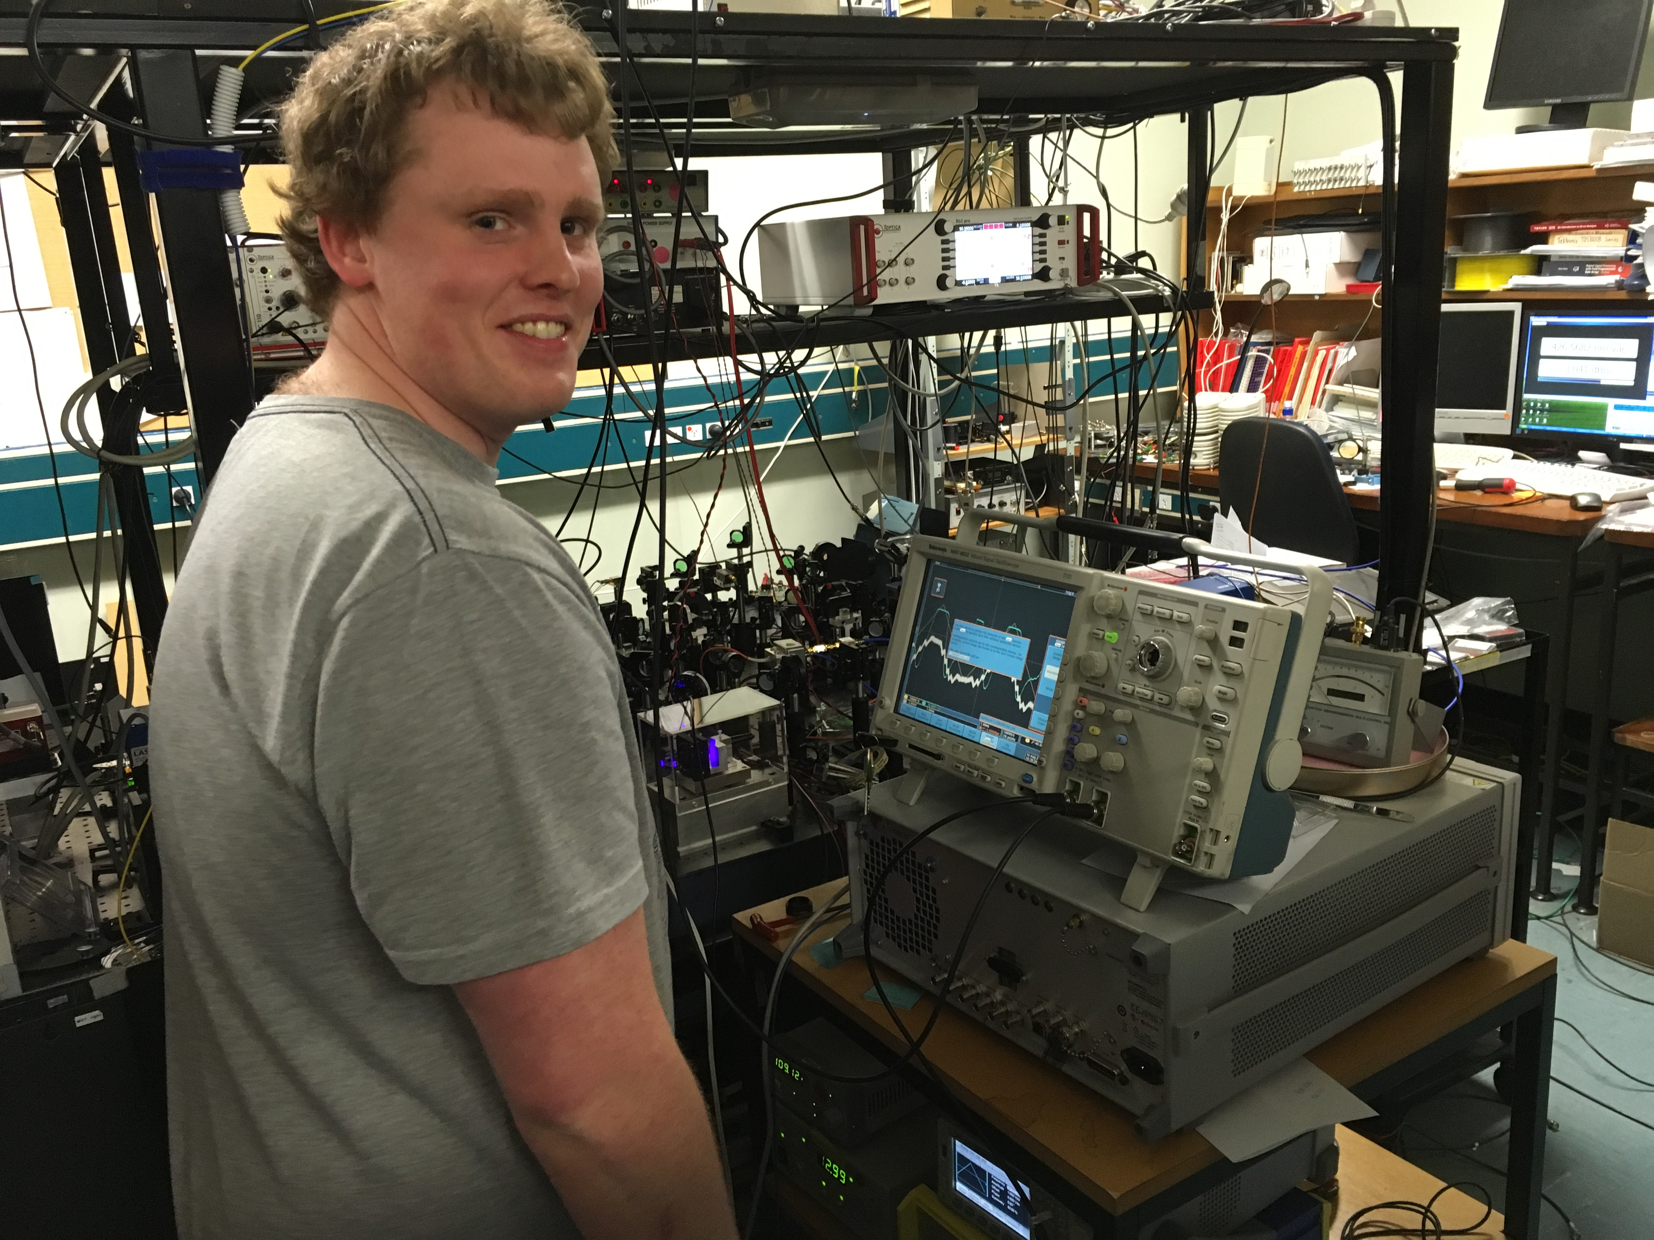
Making it real beyond www stock photos

Slide 34
Making it real beyond www stock photos

Slide 35
What could possibly go wrong?
When it does try not to get caught up in it but go to plan B gracefully!

Slide 36
What could possibly go wrong?
When it does try not to get caught up in it but go to plan B gracefully!

Slide 37
What could possibly go wrong?

Slide 38
What could possibly go wrong?

Slide 39
Try not to get caught up in it but go to plan B gracefully!

Slide 40
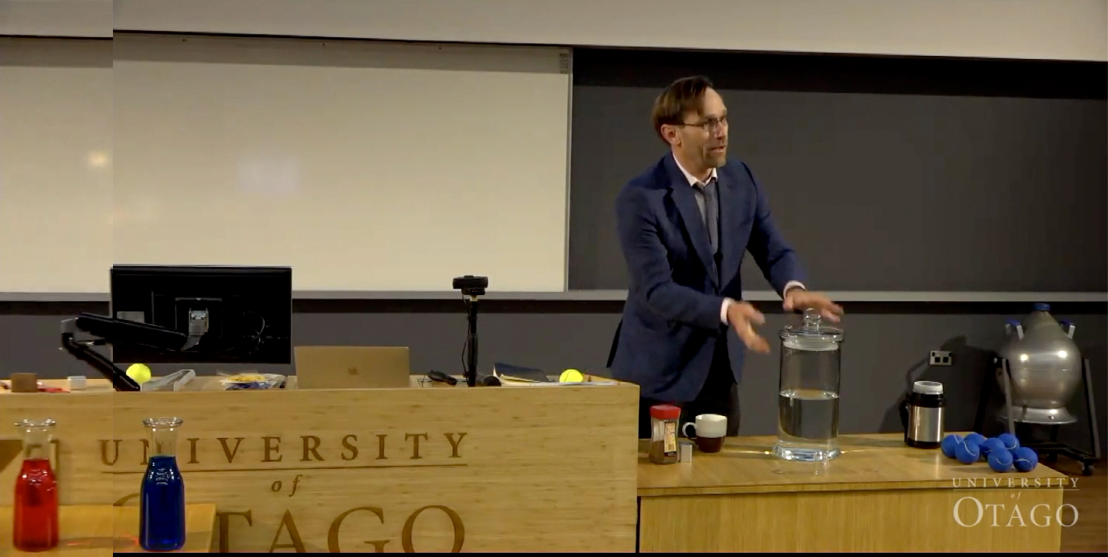
Props

Slide 41
Props

Slide 42
Don’t be chained to the lectern

Slide 43
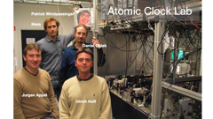
Acknowledging the contributions from others
Indirect
Direct
R. M. Potvliege and R. Shakeshaft, Movement and interplay
of the bound state, resonance, and shadow poles of
the scattering amplitude in multiphoton processes, Phys.
Rev. A 38, 6190 (1988).
😊
PRA 38, 6190 (2018)
🥵
Acknowledge those and only those who
made a direct contribution to the results
R. M. Potvliege and R. Shakeshaft, Movement and interplay of the bound state, resonance, and shadow poles of
the scattering amplitude in multiphoton processes, Phys. Rev. A 38, 6190 (1988).
…and remember your supervisor

Slide 44
Acknowledging the contributions from others
Indirect
Direct
Acknowledge those and only those who
made a direct contribution to the results
PRA 38, 6190 (2018)
…and remember your supervisor

Slide 45
Acknowledging the contributions from others
Indirect
Direct
Acknowledge those and only those who
made a direct contribution to the results
PRA 38, 6190 (2018)
…and remember your supervisor

Slide 46
Atomic Clock Lab
Patrick Windpassinger
Niels
Daniel Oblak
Jurgen Appel
Ulrich Hoff
Notes:
Here we see the four gentlemen I worked together with in the atomic clock lab

Slide 47
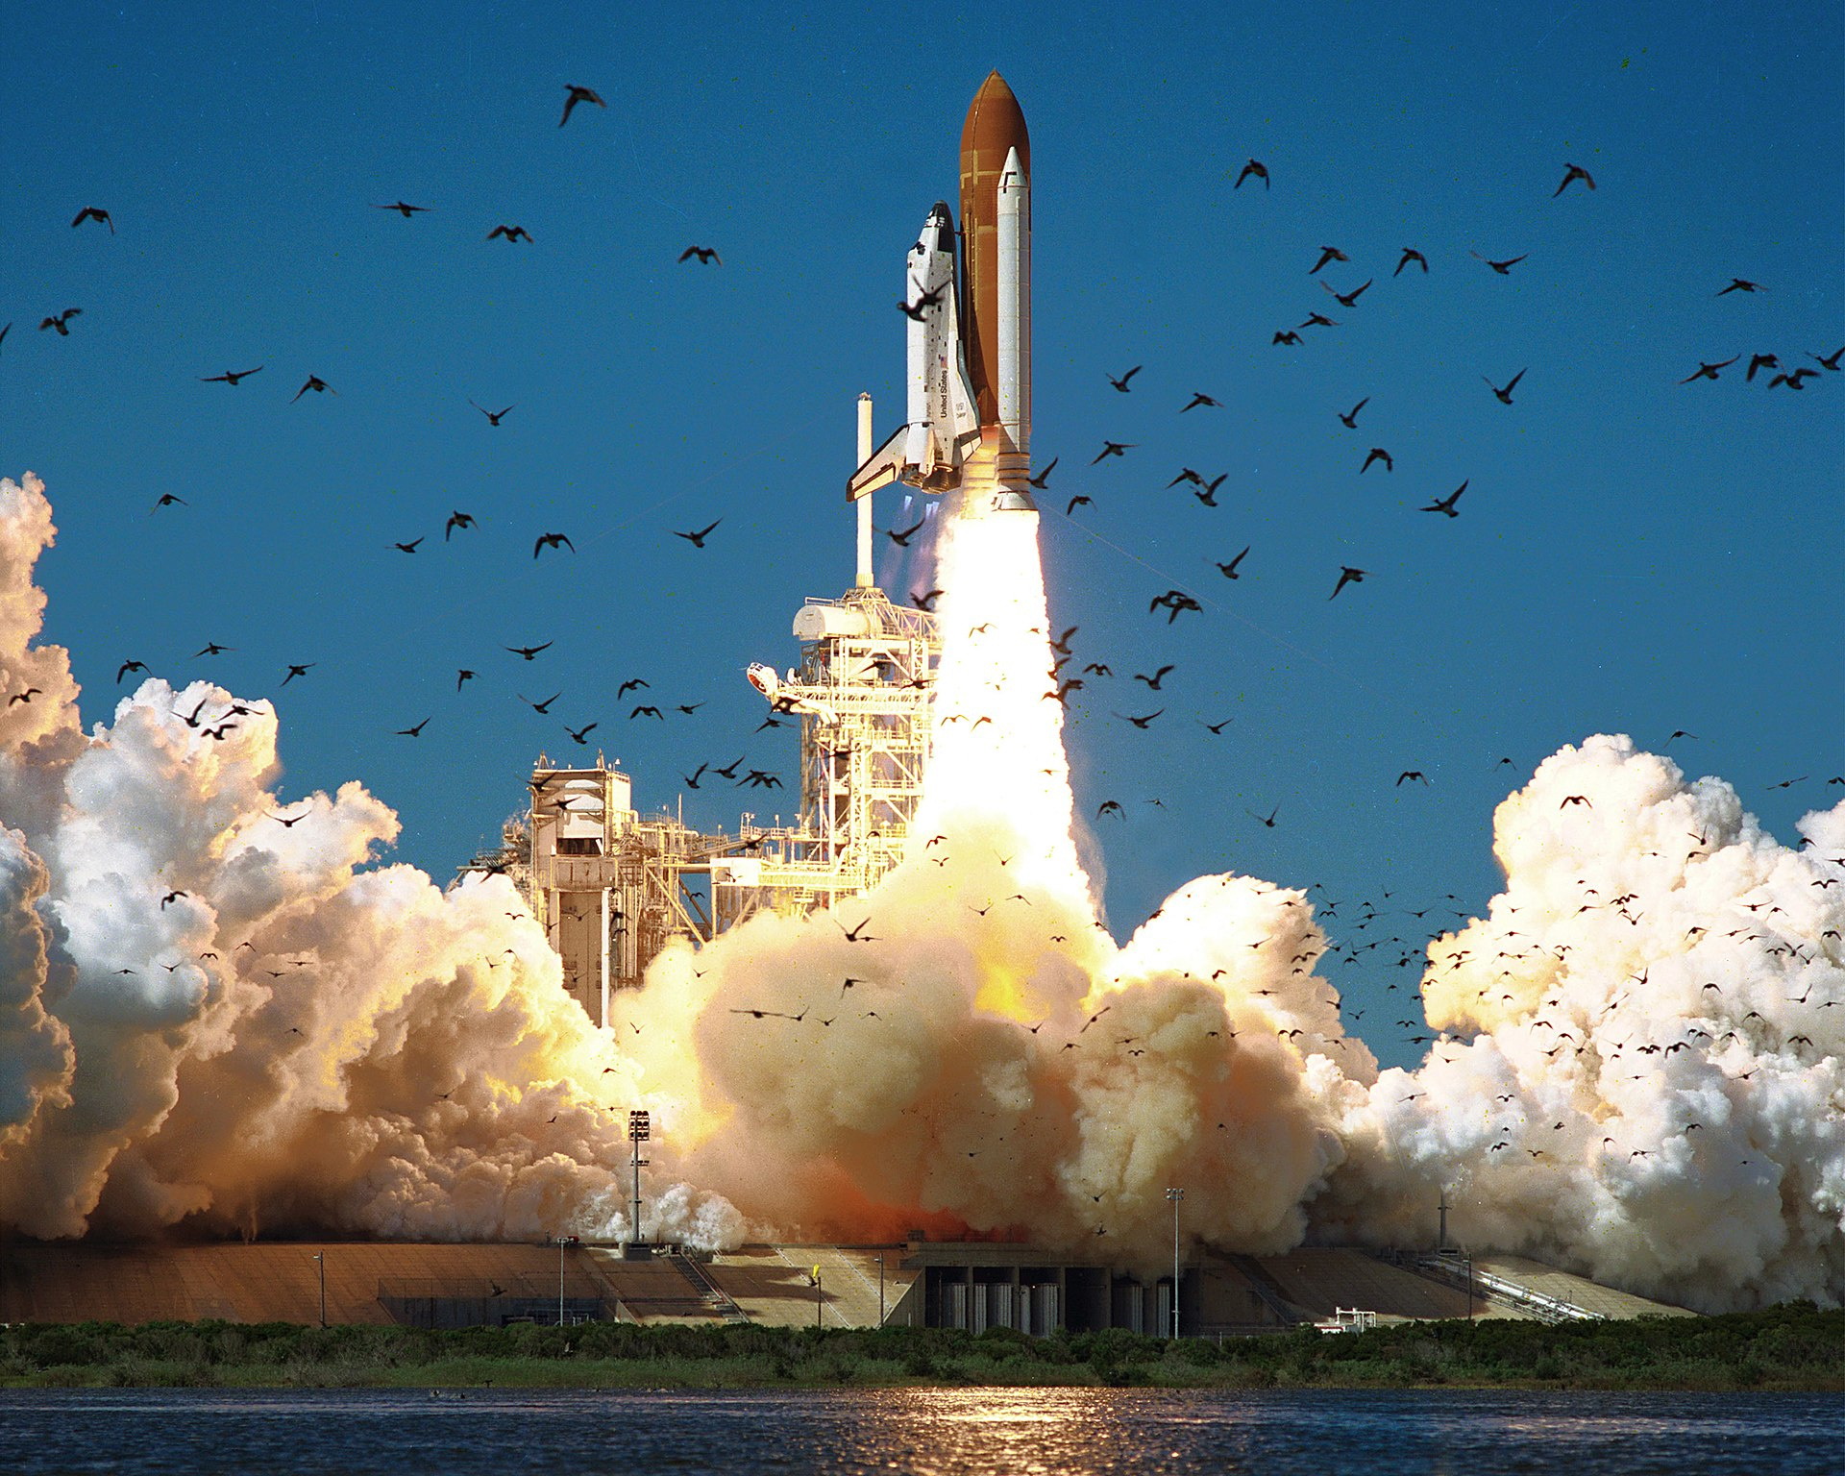
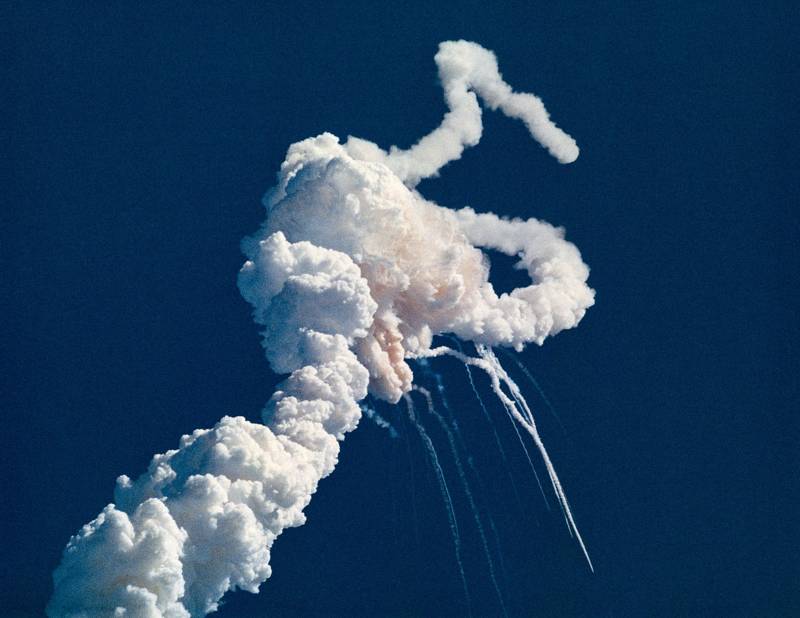
Not adhering to AE style slides can have fatal consequences
Photo credit: NASA

Slide 48
Alley
Graphs are more efficient than tables for presenting results at a talk

Slide 49
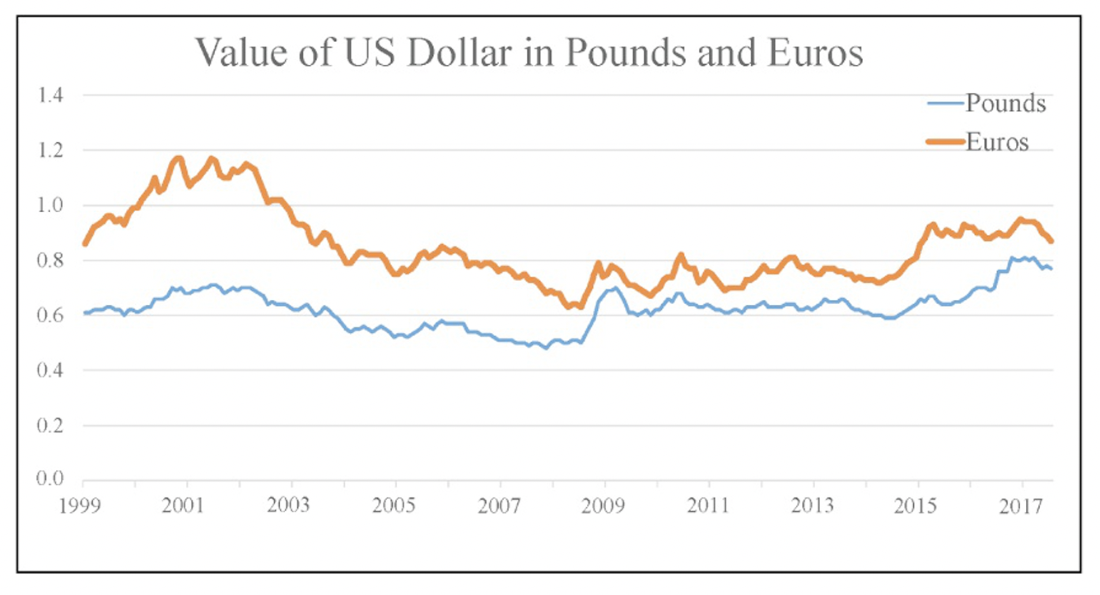
Do not use keys in graphs

Slide 50
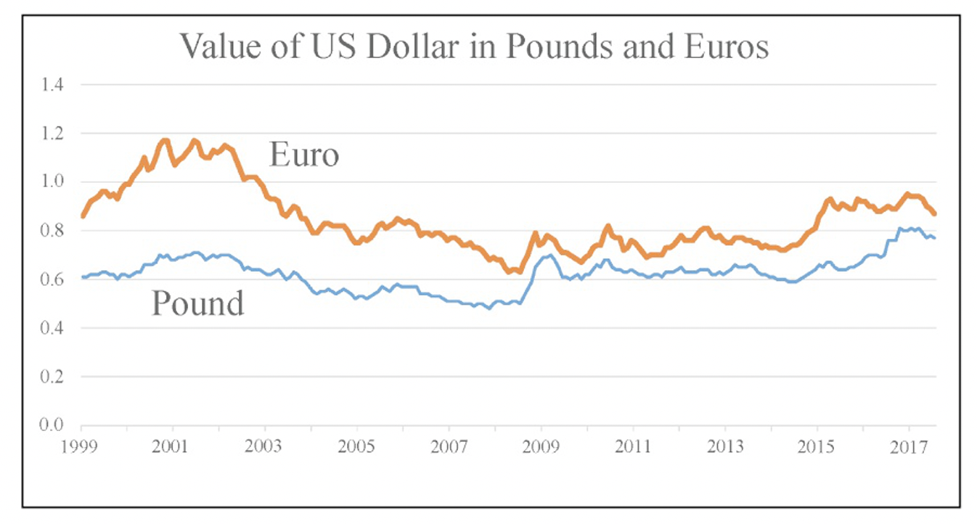
Do not use keys in graphs

Slide 51
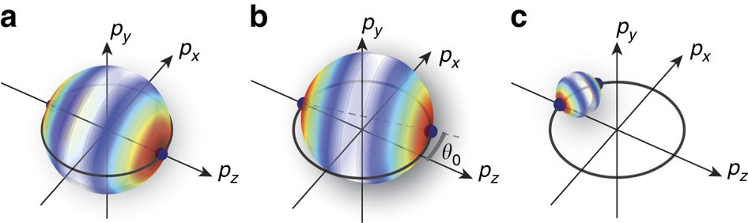
A talk is a different medium to the journal paper you based it on and people should not read captions
(a) Primary collisions in the suppression region occur between atoms (solid dark blue spheres) that have equal and opposite momenta. Collisions redistribute momenta onto a spherical shell weighted by the single-particle differential cross-section; here, red is a high value, whereas white is zero. (b) Collisions between atoms that are nearly counter-propagating occur at lower collision energies (smaller momentum shell radius) and with a collision axis slightly rotated by an angle θ₀. (c) Collisions between atoms that are nearly co-propagating occur at much lower collision energies and all final momenta lie close to the original collision axis.

Slide 52
Develop a story
Getting started

Slide 53
Develop a story
Getting started
Vision/Importance
Empowerment promise
Route
Authority

Slide 54
Compose and memorise you opening sentence(s)
“First impressions are EXTREMELY important. This is true in everyday life. It holds true on the special occasions in life where it is do or die. And it holds true when giving a scientific presentation. You do NOT want to miss out on the opportunity of creating a positive momentum. And for a talk this begins with your first slide…

Slide 55
Develop a story
Getting started
How to finish?
Vision/Importance
Empowerment promise
Route
Authority

Slide 56
Develop a story
Getting started
How to finish?
Vision/Importance
Empowerment promise
Route
Authority
Contributions!

Slide 57

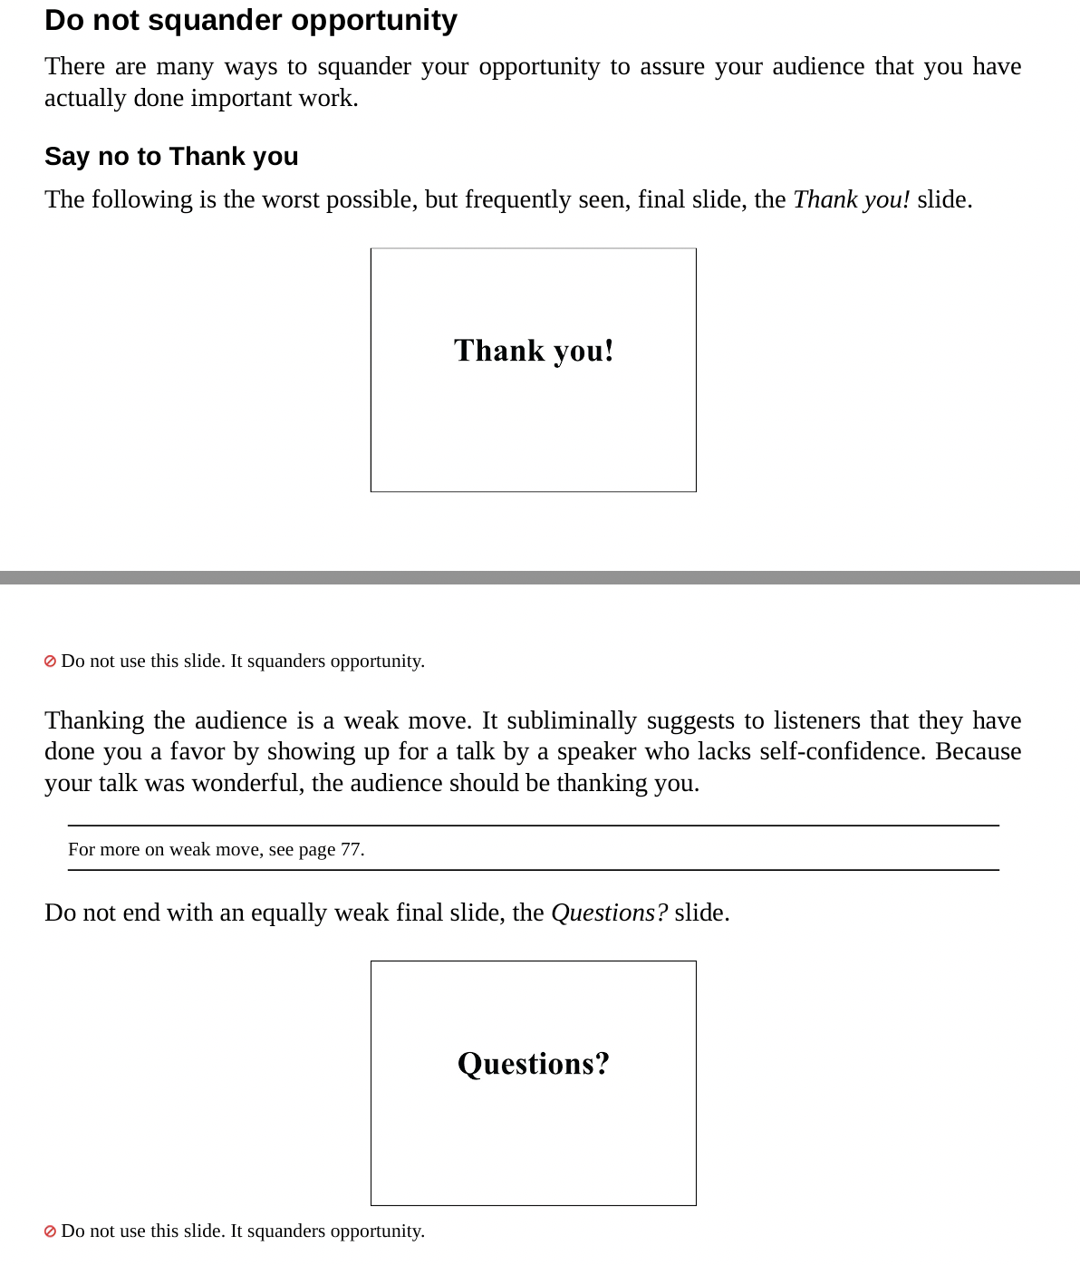

Slide 58
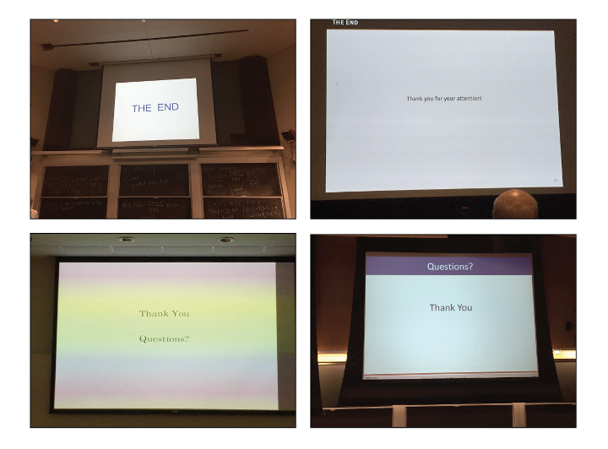

Slide 59
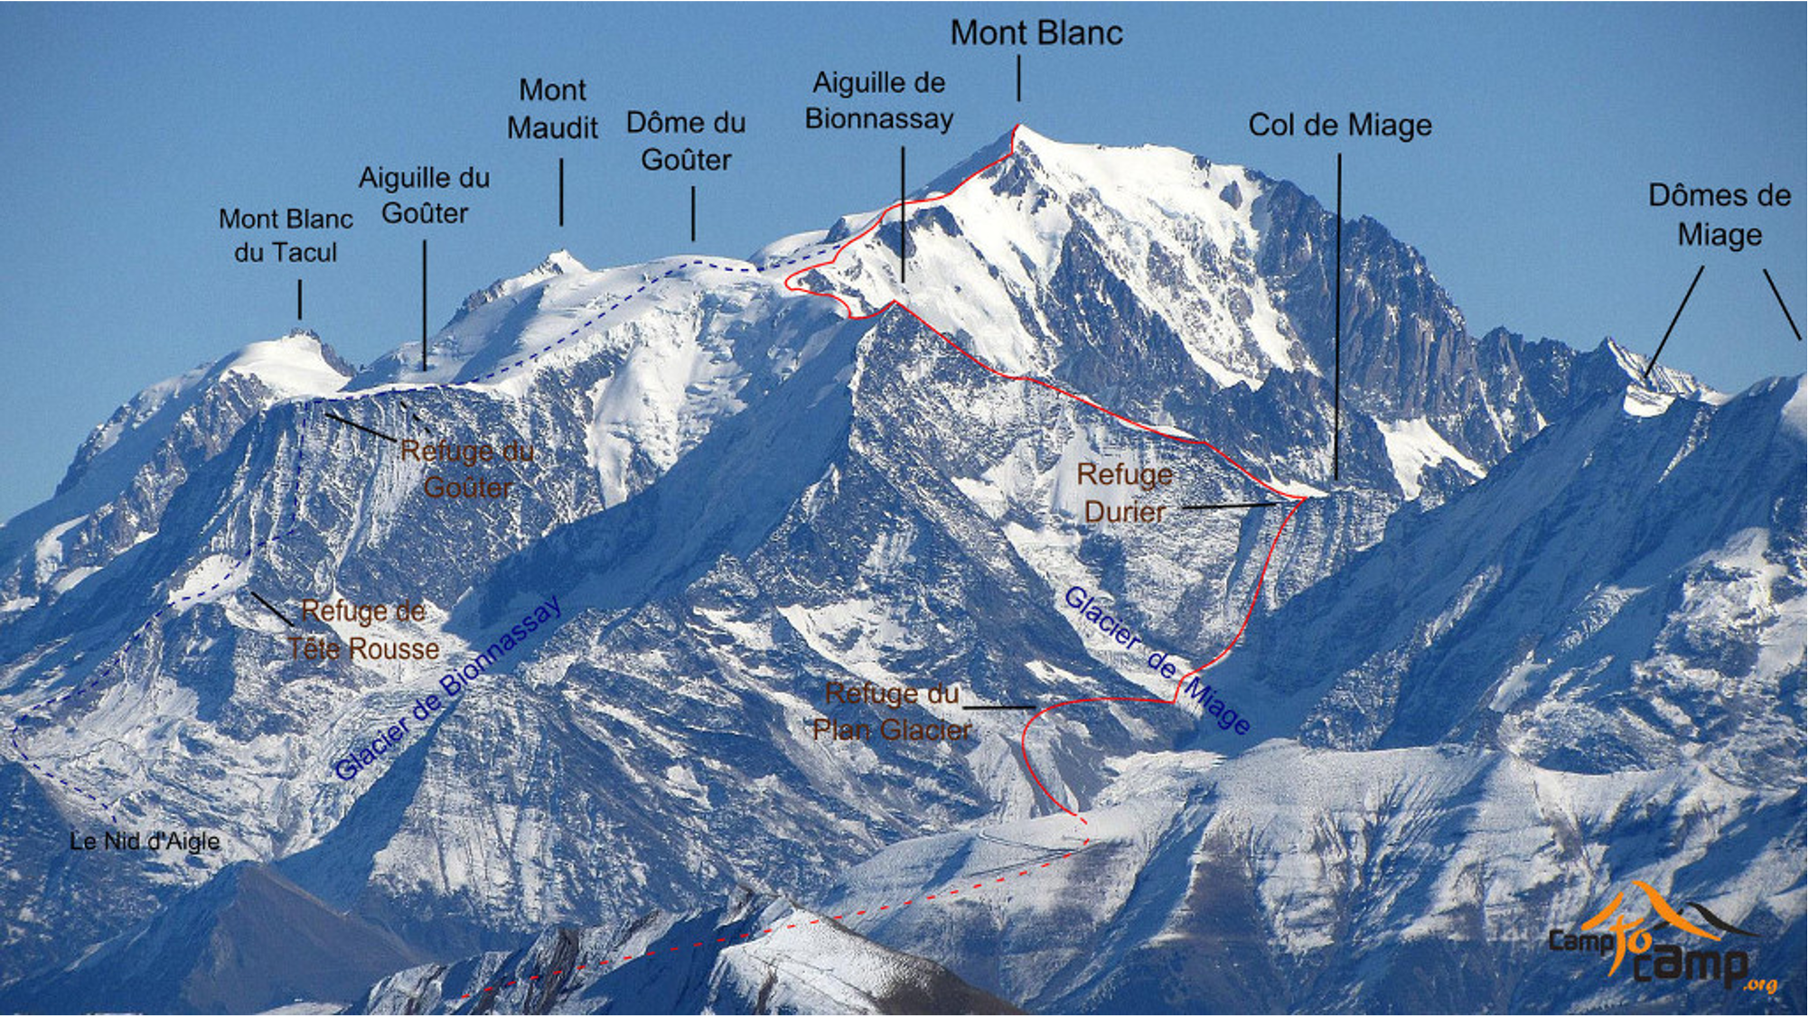
Develop a story
Reiterate
New perspectives
(re)-engage audience
Getting started
How to finish?
Vision/Importance
Empowerment promise
Route
Authority
Contributions!

Slide 60
